Slide 1
Introduction to Quantum Computing: From a Layperson to a Programmer in 30 Steps
Hiu-Yung Wong
https://link.springer.com/book/10.1007/978-3-030-98339-0
https://www.amazon.com/Introduction-Quantum-Computing-Layperson-Programmer/dp/3030983382
Playlist: https://www.youtube.com/watch?v=K28NnFE17J0&list=PLnK6MrIqGXsJfcBdppW3CKJ858zR8P4eP&index=59
https://www.youtube.com/watch?v=68N_kBbVRGQ&list=PLnK6MrIqGXsJfcBdppW3CKJ858zR8P4eP&index=60

Slide 2
Schroedinger Equation and Qubit Manipulation

Slide 3
Evolution of Qubit

Slide 4
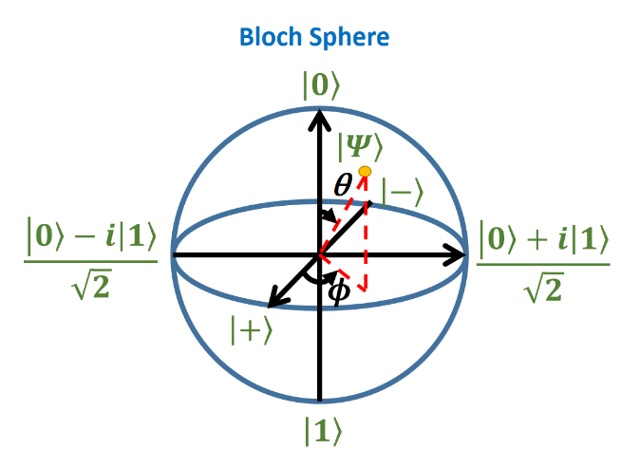
Example of rotation

Slide 6
Magnetic Moment

Slide 7
Spin, Angular Momentum and Magnetic Field (Now use the idea of classical momentum to understand spin)
g-factor: a proportionality constant that relates the different observed magnetic moments μ of a particle to their angular momentum quantum numbers and a unit of magnetic moment (to make it dimensionless), usually the Bohr magneton or nuclear magneton.

Slide 8
Hamiltonian of a spin under an external Magnetic Field

Slide 9
Construct the matrix for the Hamiltonian

